Slide 1
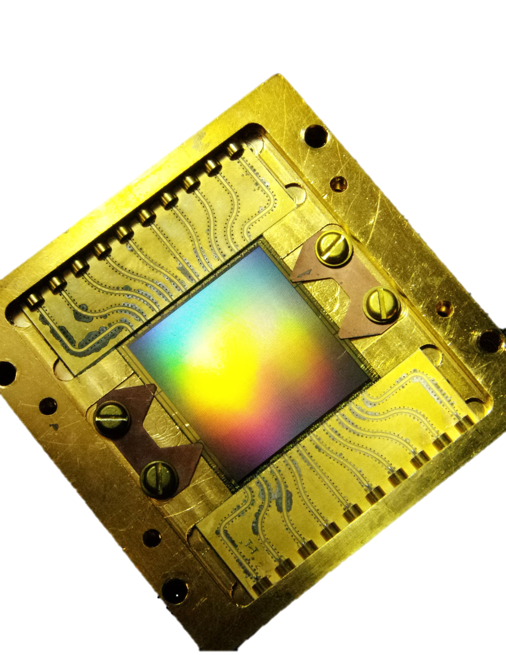
Maximizing the Dynamic Range of Microwave Kinetic Inductance Detectors through Tone-Tracking Firmware
Jonathan Hoh
Doctoral Candidate of Astrophysics
Masters Student of Electrical Engineering
Adrian Sinclair
Doctoral Candidate of Astrophysics
Ryan Stephenson
Bachelors Student of Electrical Engineering/Physics

Slide 2
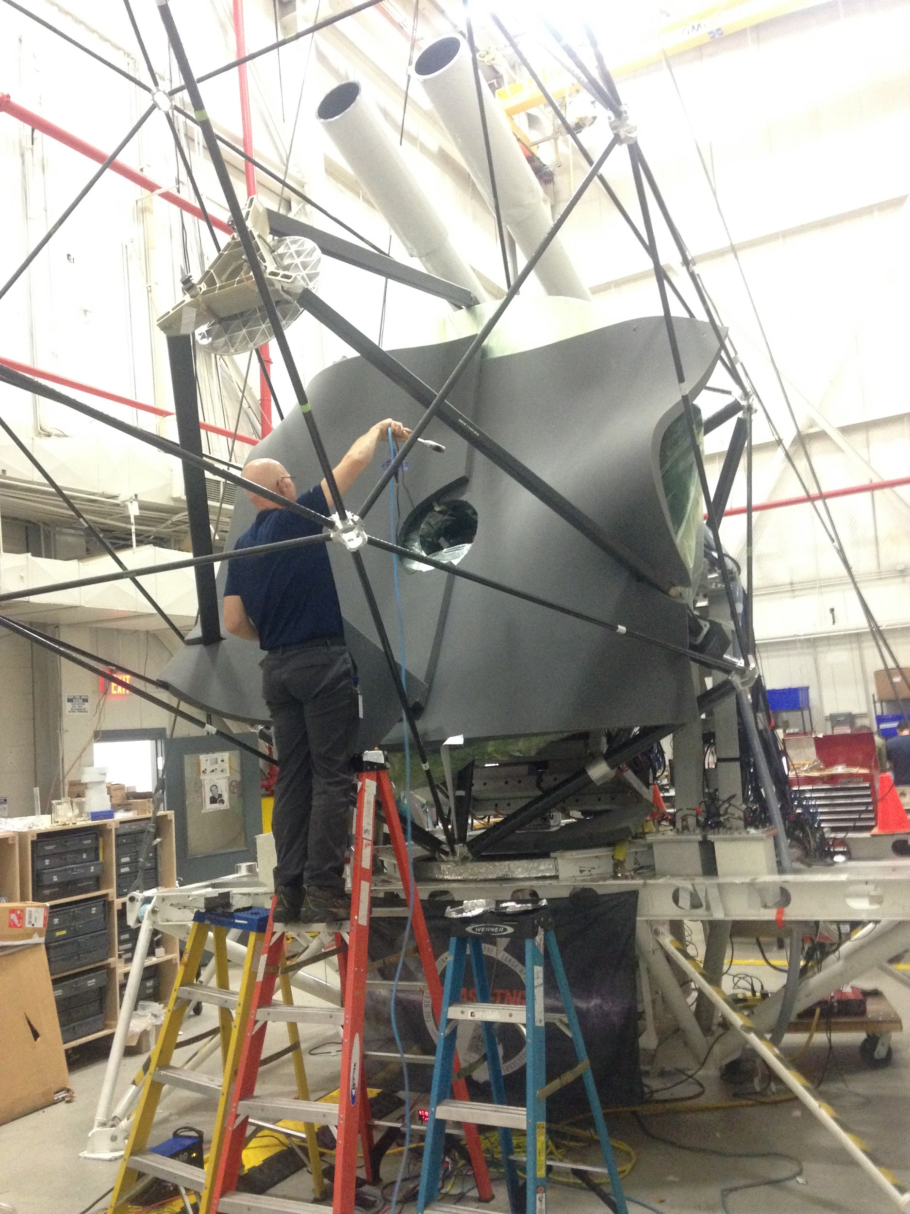
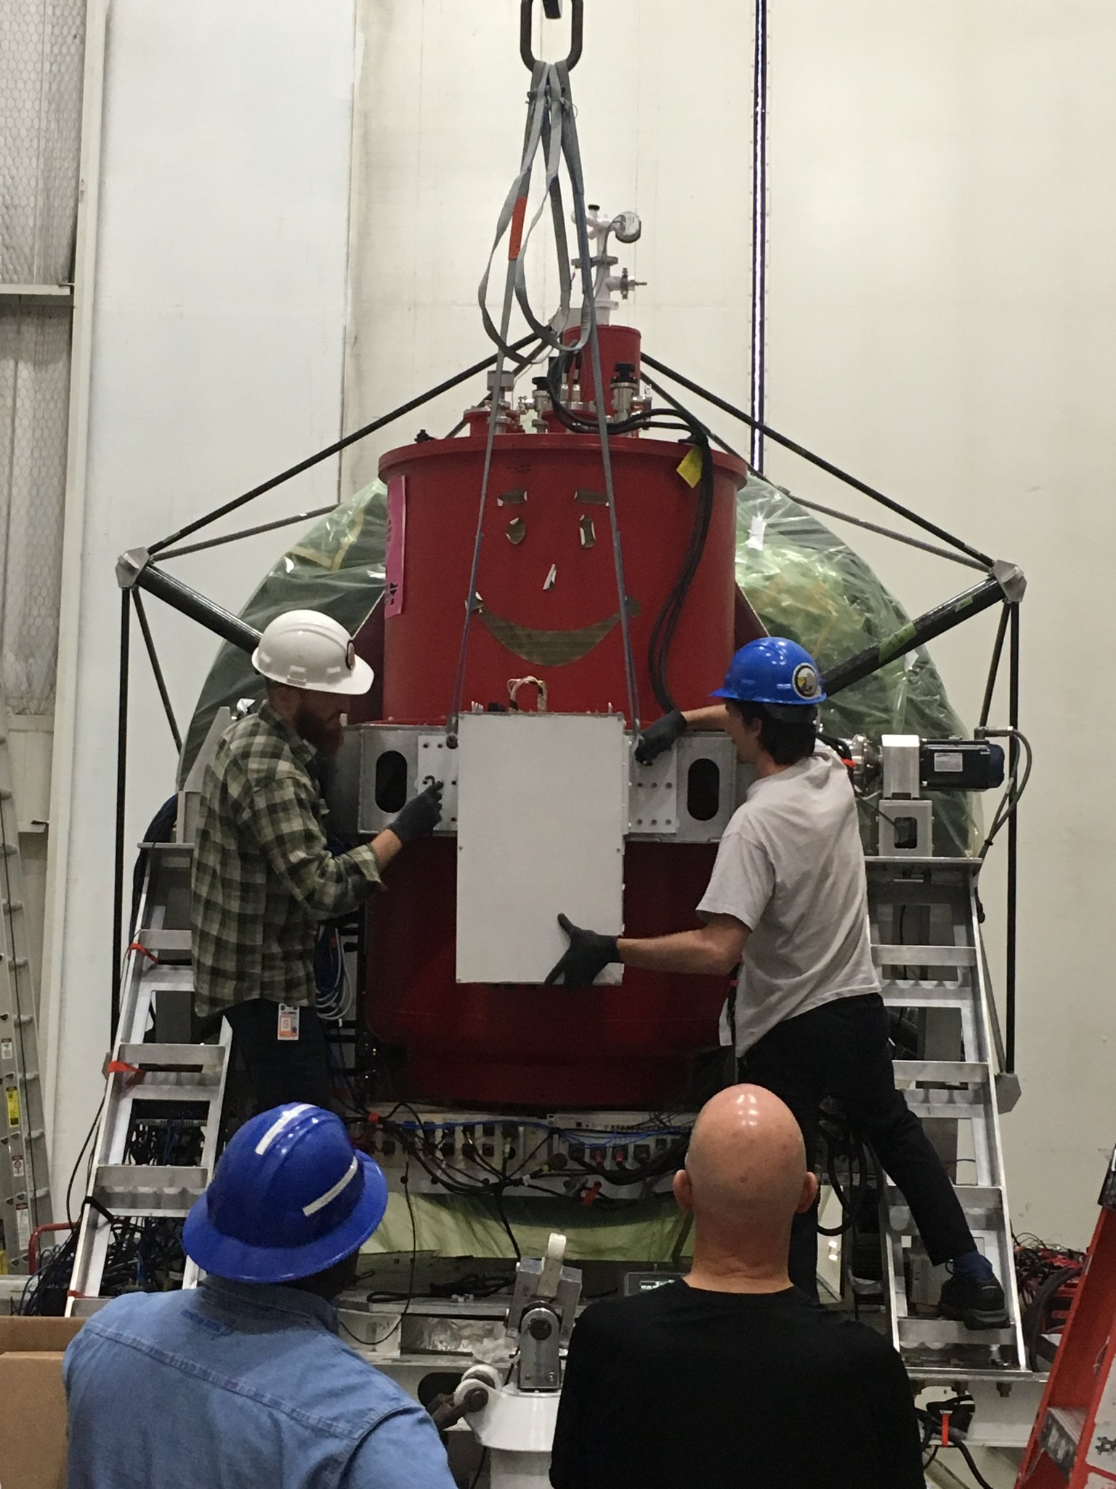
Who Uses MKIDs?
BLAST-TNG:
Measuring B-fields around molecular clouds and in galactic ISM
Dust particles orient to B-fields
Light passing through dust grains is polarized
Polarization is mapped through array of MKIDs
SuperSpec
Olympo
MAKO
IRAM

Slide 3
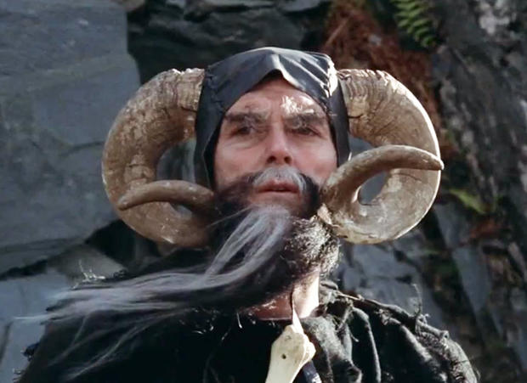
Next up: TIM (Terahertz Intensity Mapper)
BLAST architecture+spectrometer (240-420μm)
Surveys of CII, OI, OIII for ~100 galaxies
(0.5 <z< 1.5), on scales from (1 - 50 Mpc)
CII mapping of galaxies
Star formation rate
Structure mapping/tomography

Slide 4

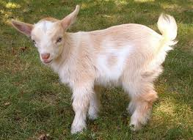
What are KIDs?
The theory of detection through kinetic inductance

Slide 5
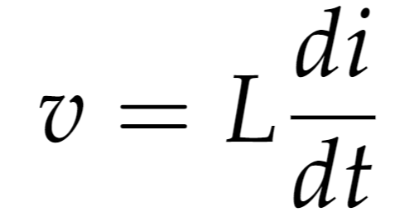
What is kinetic inductance?
Inductance can be seen as “electrical inertia”
Resists change in current
Can come from geometric or kinetic sources
All charged particles in motion have kinetic inductance

Slide 6
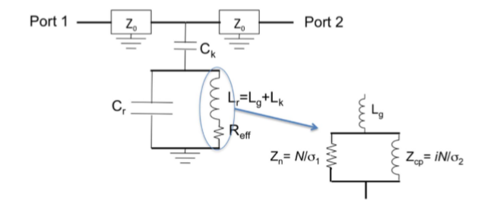
Kinetic Inductance Detectors are Designed as Fancy Resonators
Can be modeled as an RLC circuit

Slide 7
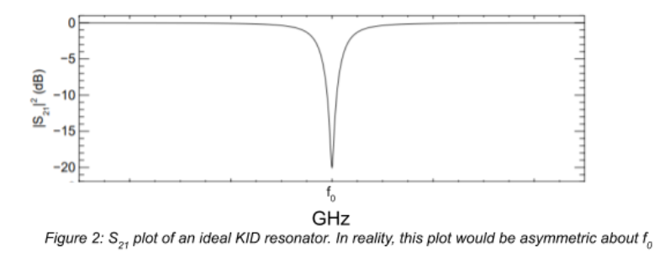

Resonators have characteristic frequency ∝ 1/√$\left(LC\right)$

Slide 8


MKIDs are Superconductors
Superconductors are materials who have zero resistance below some Tc
In this superconducting band, electrons double up into Cooper pairs
Photons with enough energy break these Cooper pairs and banish electrons from the superconducting band

Slide 9
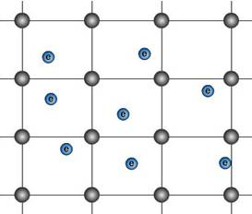
Ionic Lattice of a Material

Slide 10
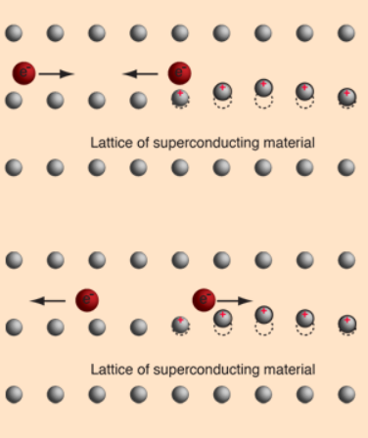
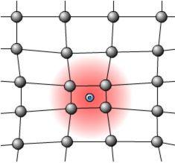
Some Elementary Visuals

Slide 11
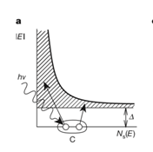
Photons Change Inductance
Incident photons can break Cooper pairs
Broken pairs have a higher relative kinetic energy
Increasing inductance decreases resonant frequency
We probe the MKIDs and measure shifts in resonance properties to determine incident power

Slide 12
Setting the Stage
Basics of reading out KIDs

Slide 13
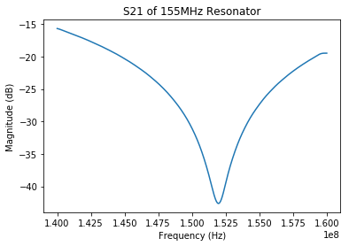
Transmission of Resonator

Slide 14
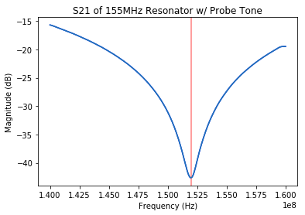
Probe the MKID and expect little transmission

Slide 15
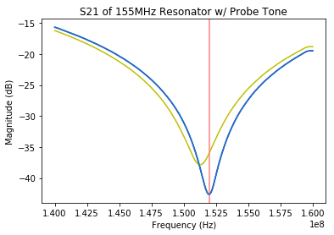
A Incident Power Appears!
Transmission of our probe tone increases

Slide 16
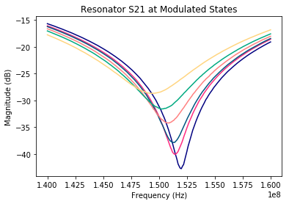
Multiple States of a Resonator

Slide 17
A Resonator with Multiple Modulated States

Slide 18
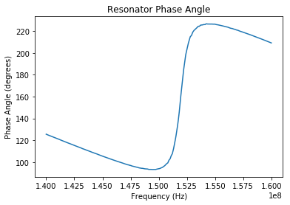
A Similar Effect in Phase Space
Frequency v. phase plot for a resonator

Slide 19
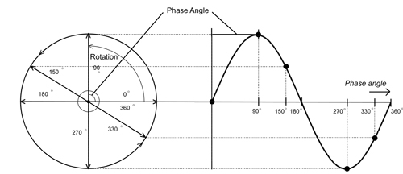
Quick Phase Reminder

Slide 20
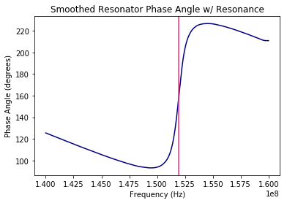
A Similar Effect in Phase Space
Idealized frequency v. phase plot for a resonator

Slide 21
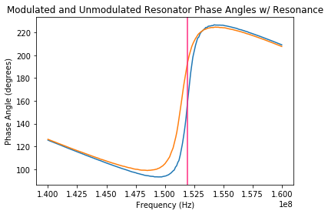
The Same Incident Power
Phase angle increases

Slide 22
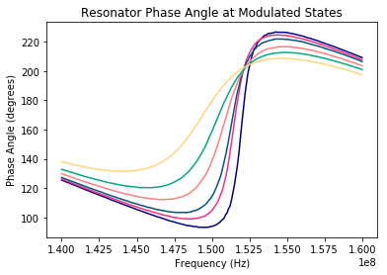
Phase Response of Modulated Resonator

Slide 23
These Relationships Allow for Detection
Phase and amplitude info are read out
Relationship between shift and incident power
We do this for 1000s of detectors at once!

Slide 24
The Fly in the Ointment

Slide 25
The Dynamic Range Pickle
MKIDs should have exceptional dynamic range
Readout currently limits this range
What happens when a detector drifts too far?
How can we find it again?

Slide 26
Let’s Revisit our Transmission Plots

Slide 27
A Incident Power Appears!
Transmission of our probe tone increases

Slide 28
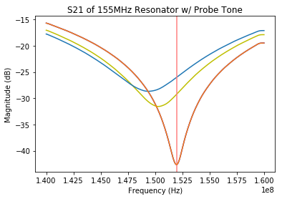
Too much incident power, amplitude info becomes noisy

Slide 29
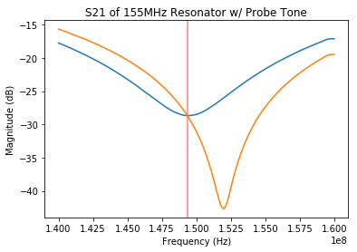
We have to do an entire new VNA sweep!

Slide 30
How can we track the tones in-situ?

Slide 31
Creating a Control System to Tone Track
In order to track a parameter, you need an invariant
For resonators, resonant phase
Use phase lock loop to track phase
Take advantage of linearity in phase v freq
Use a feedback controller to relocate freq

Slide 32
Back to the Phase Plot

Slide 33
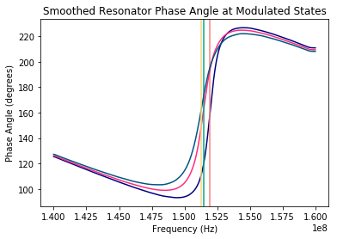
Resonant Phase is Invariant!

Slide 34
Photon shifts phase
Δφ

Slide 35
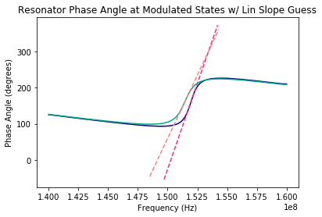
We can directly read the phase and the slope!
Δφ
Δf

Slide 36
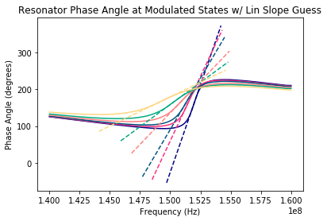
Side note: Linear slope must be estimated first

Slide 37
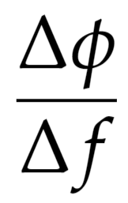
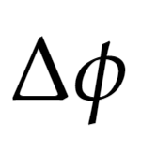
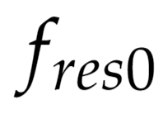

What we have:
What we want:

Slide 38
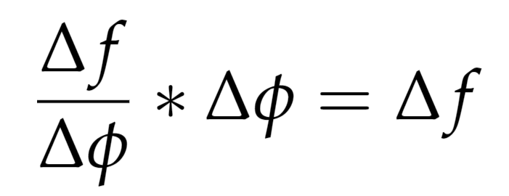
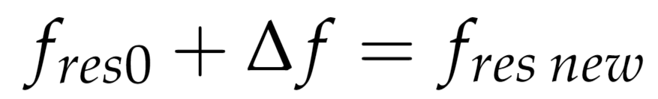
This becomes a simple problem (in theory)

Slide 39
Shift the frequency back to resonance!
Δφ
Δf

Slide 40
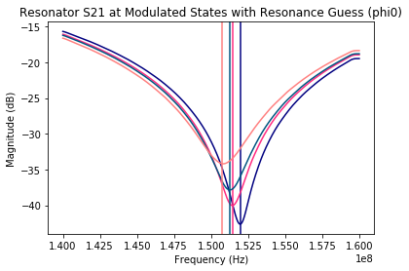
“Guessing” Resonances with Phi0

Slide 41
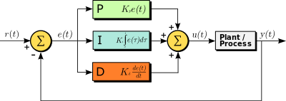
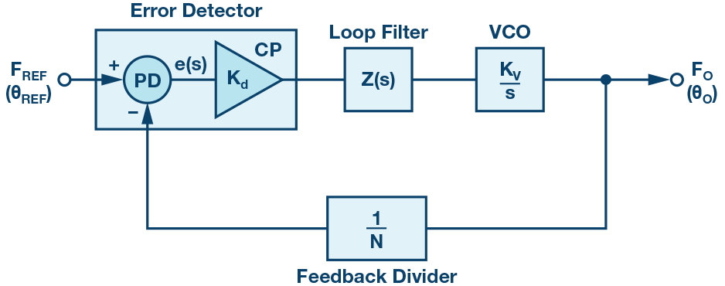
Diving into the Land of Bits
This algorithm is based on:
Phase-lock-loop
PID controller (just the P and I)

Slide 42
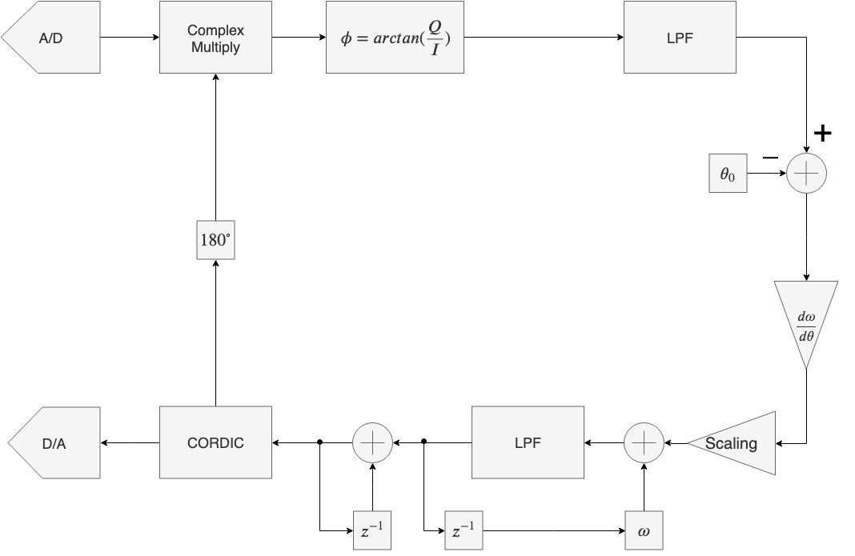
Tone-Tracking Algorithm

Slide 43
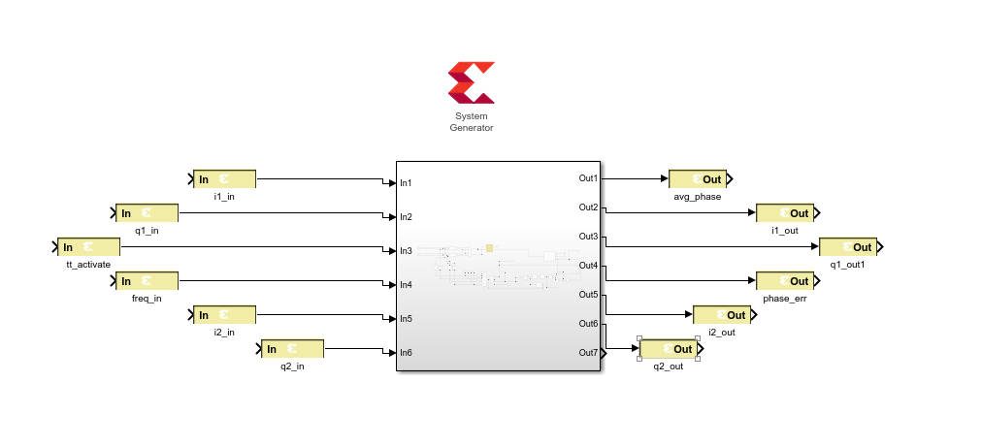
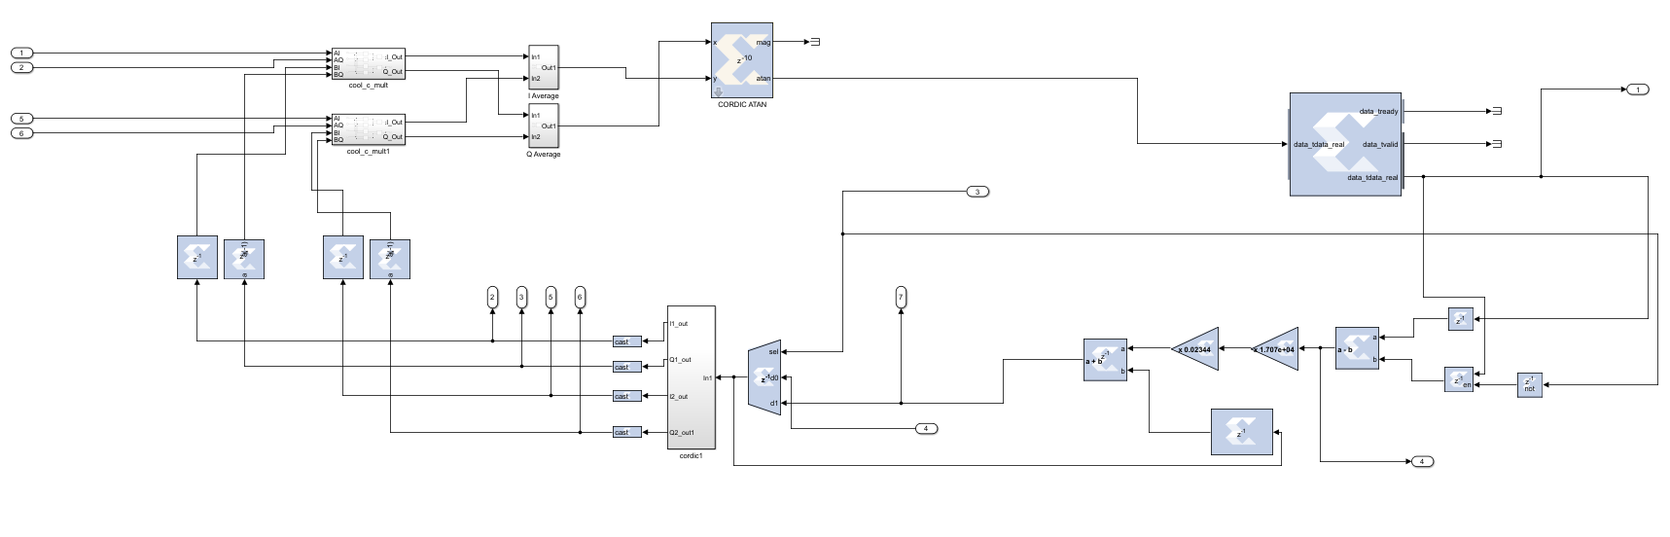
In the World of Simulink

Slide 44

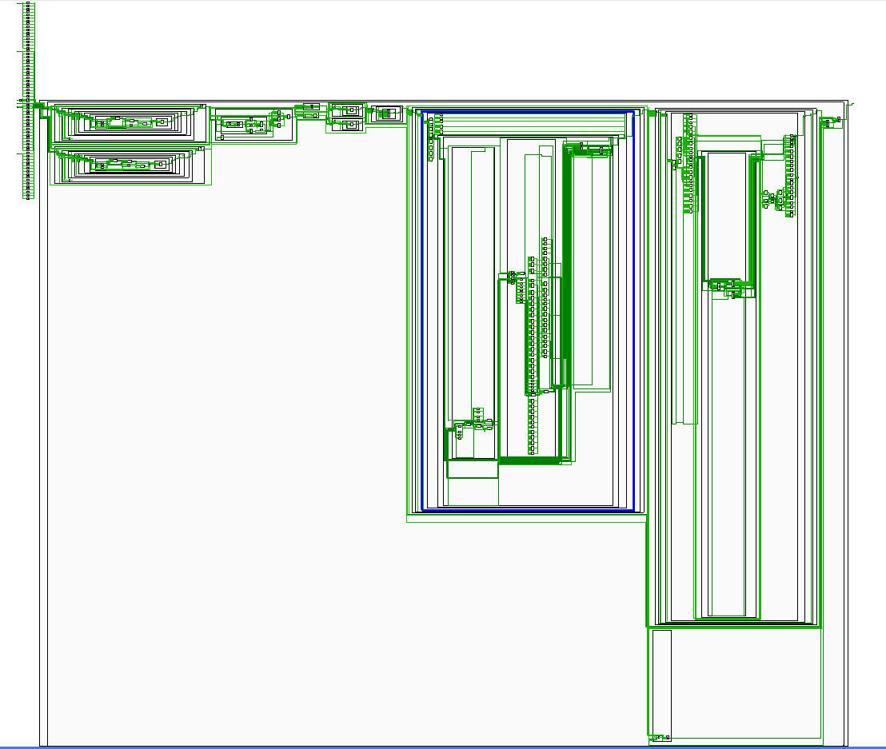

Slide 45
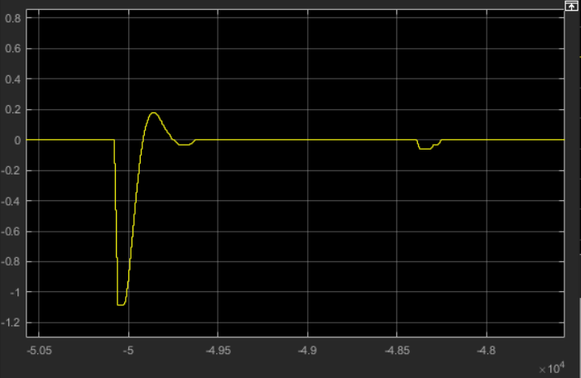
Some Simulation Results
Phase Error
Clock Cycles (4ns)

Slide 46
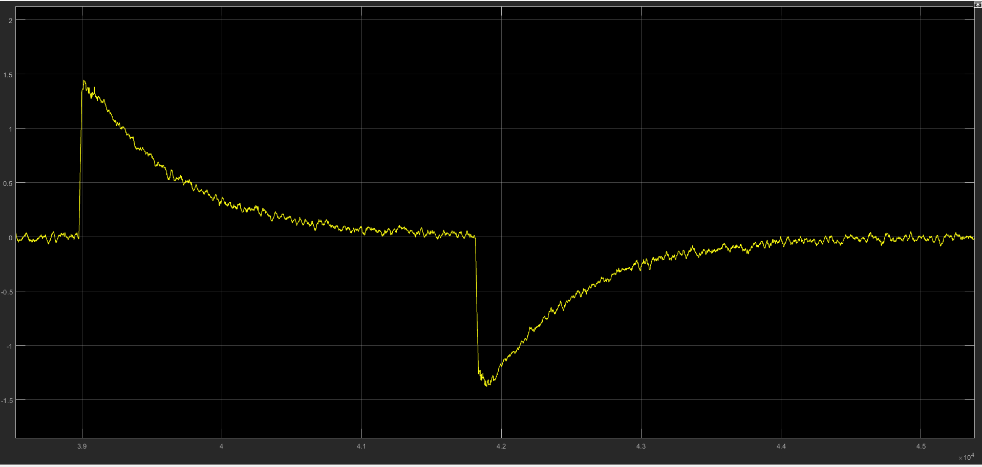
Noisy Simulation Results
Phase Error
Clock Cycles (4ns)

Slide 47
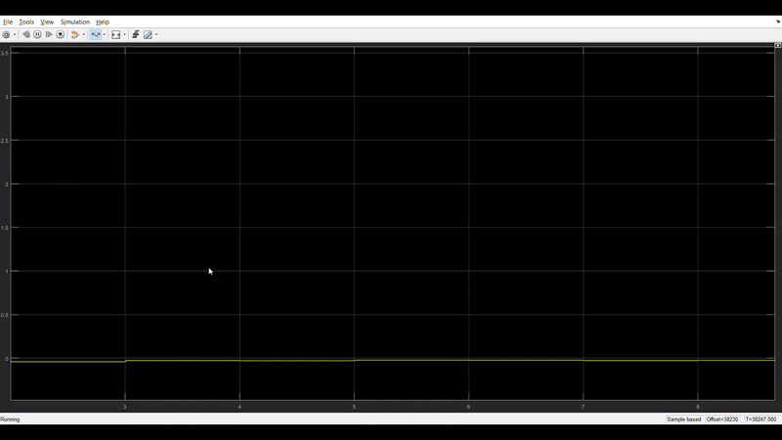
Phase Error Minimization of Noisy Data
Phase Error

Slide 48
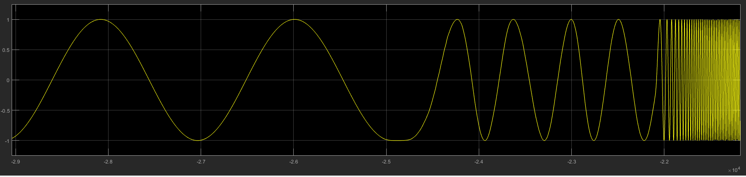
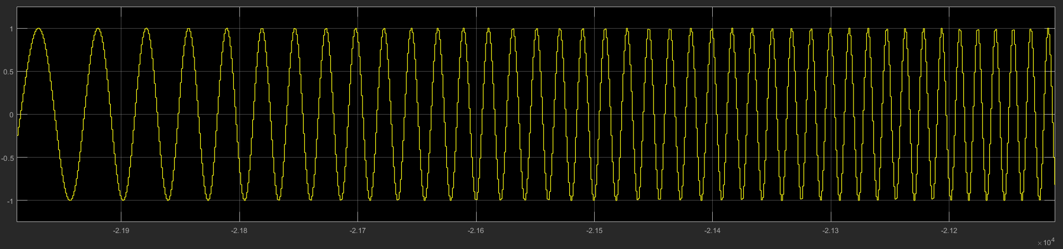
Time Stream of Simulated Waveform Generator
Amplitude
Amplitude

Slide 49

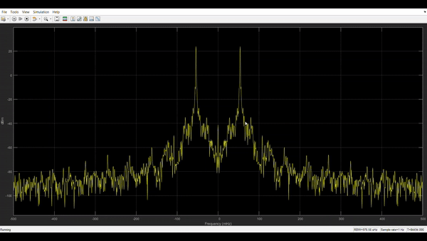
Watching the Algorithm in Fourier Space

Slide 50
How Will this Work?

Slide 51
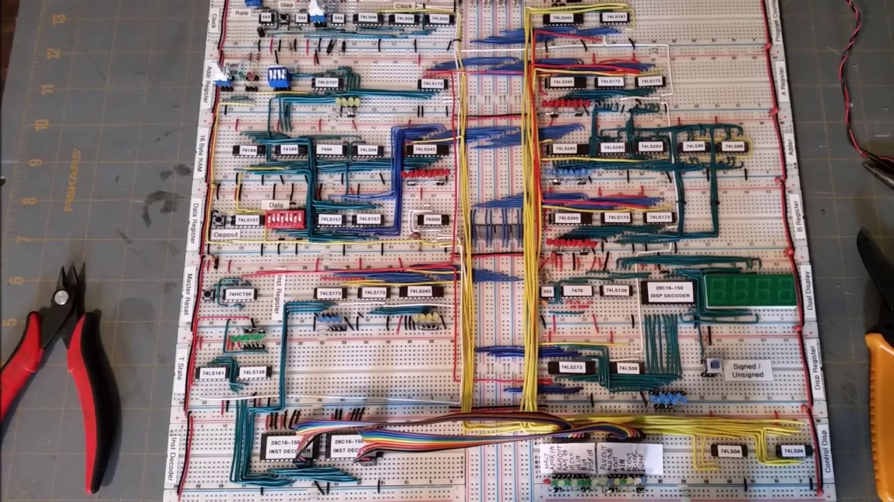
FPGAs are the answer
Field Programmable Gate Array
Analogous to digital breadboard
Extremely reconfigurable logic
Huge bandwidth
Fast
Torturous to use

Slide 52
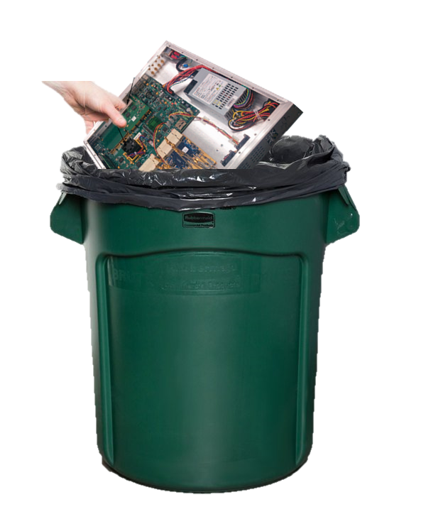
What’s our FPGA of Choice?
Previous decade has used ROACH2 FPGA
Tone-tracking is resource INTENSIVE
We require more modern technology

Slide 53

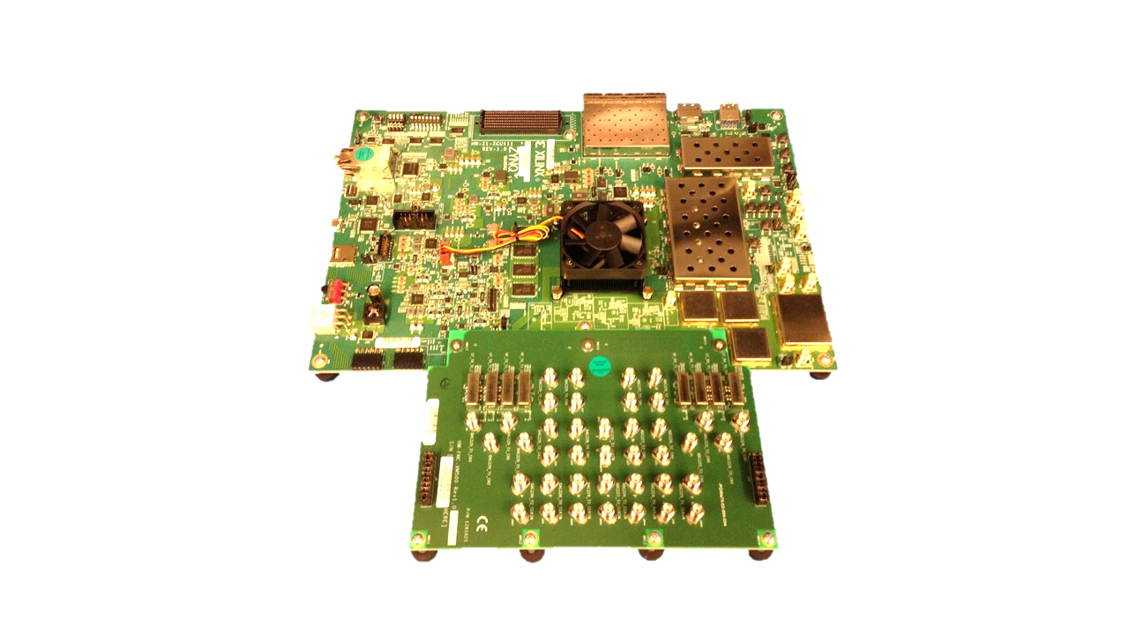
Xilinx UltraScale+ RFSoC (zcu111)
8x 12bit-DACs & 14bit-ADCs running at 4GSPS integrated directly on the chip
Arm processor can run Linux and Python
Up to 1GB ethernet connection

Slide 54
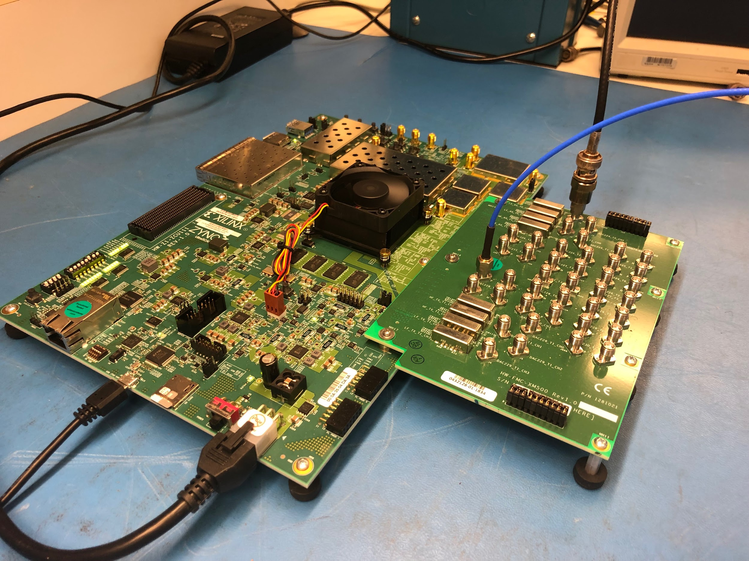
Current Progress on the RFSoC Battle
ADC/DAC data converters are now working
Successful tone creation and loopback
PID/PLL feedback loop has been converted to HDL
An international RFSoC Strike Force created

Slide 55
What’s Next
Single-channel tone tracking is close
Bit manipulation issues
Integration into general RFSoC architecture
Real results
Resource management for multiplexing
Vacuum testing of RFSoC
Open Sourcing of all materials

Slide 56
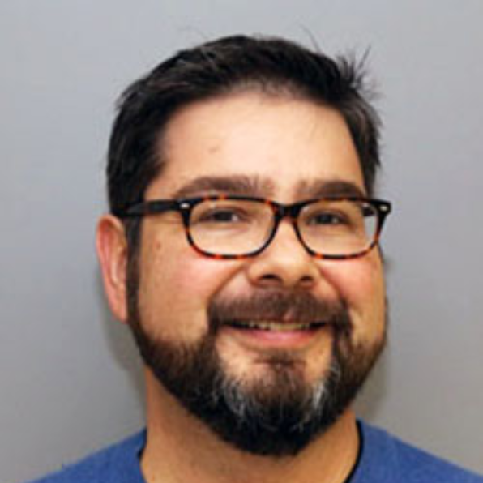
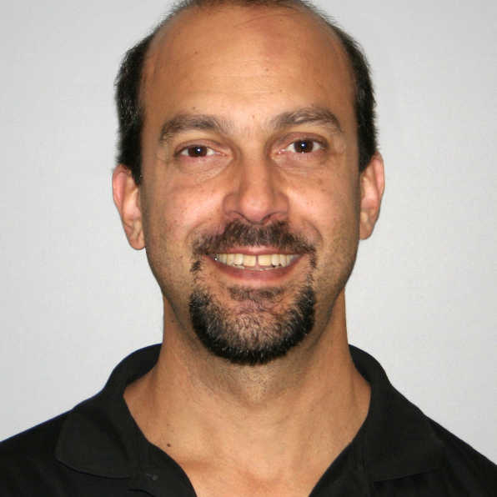

Big Thanks
Chris Groppi
Phil Mauskopf
Jnaneshwar Das
Lucas Ziomek
ISTB4 Basement Lab Crew

Slide 57

Special Thanks

Slide 58
QUESTIONS?
Questions and concerns:
jrhoh@asu.edu

